Slide 1
Autonomous Driving System Fault Prediction in Complex Scenarios Using CARLA
Daze lu
MAY 7

Slide 2
INTRODUCTION
To keep self-driving cars safe, it’s important to catch problems in key parts like perception, planning, and control before they cause serious failures. But testing in the real world is expensive, risky, and rare situations are hard to find. To solve this, the researchers use the CARLA simulator. It lets them create tough driving situations—like bad weather, busy traffic, and car breakdowns—in a safe and low-cost way. This helps them test self-driving systems more easily and safely.
Contributions
Developed a simulation-based fault prediction framework using CARLA to emulate diverse and failure-prone scenarios.
Integrated the TransFuser model for end-to-end vehicle control with multi-modal sensor fusion (camera + LiDAR).
Objectives
Predict AV system failures using an LSTM model trained on simulated time-series data.
Identify environmental and behavioral factors that contribute to AV breakdowns.
Support pre-deployment safety validation by revealing hidden failure patterns in AV decision-making.

Slide 3
CURRENT CHALLENGES
Rare failures are hard to reproduce in real-world driving due to safety risks and unpredictable occurrence.
Public datasets lack coverage of the complex, high-risk scenarios (e.g., sudden pedestrian crossing, sensor degradation, or mechanical failure) that truly challenge AV systems.
Existing studies often isolate subsystems, focusing only on perception (e.g., sensor fault detection) or control (e.g., planning errors), which limits holistic understanding.

Slide 4
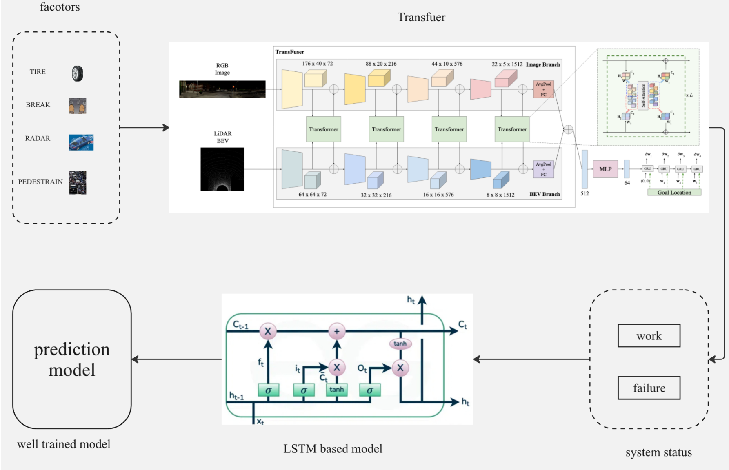
FRAMEWORKS

Slide 5
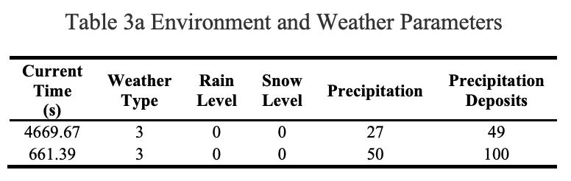
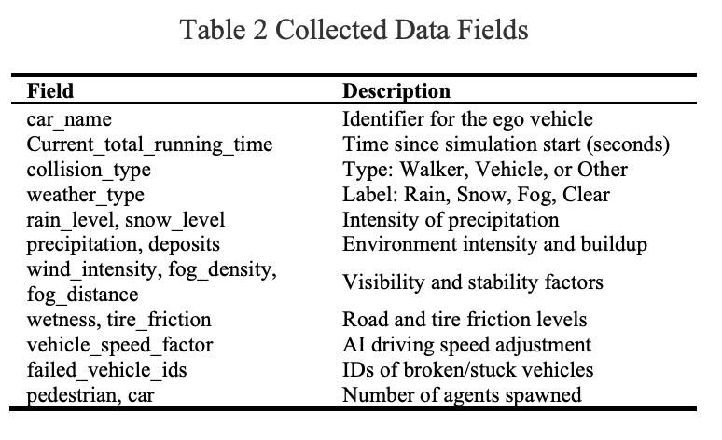
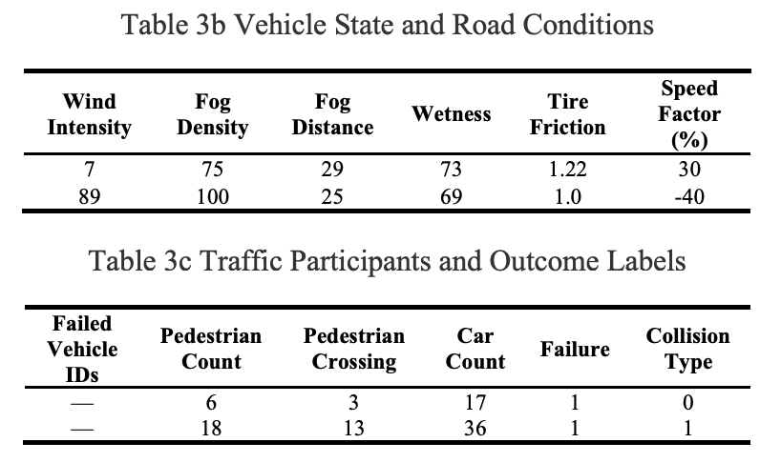
DATA COLLECTION

Slide 6
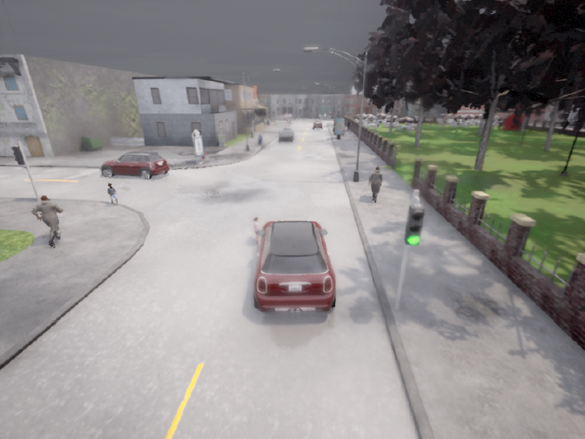
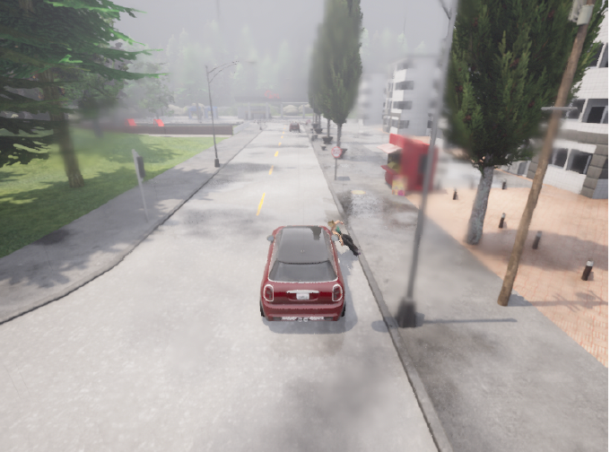
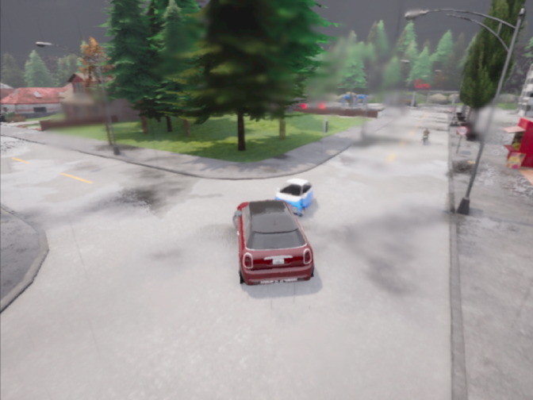
DATA COLLECTION-2
examples
Raining
Fog
clear

Slide 7
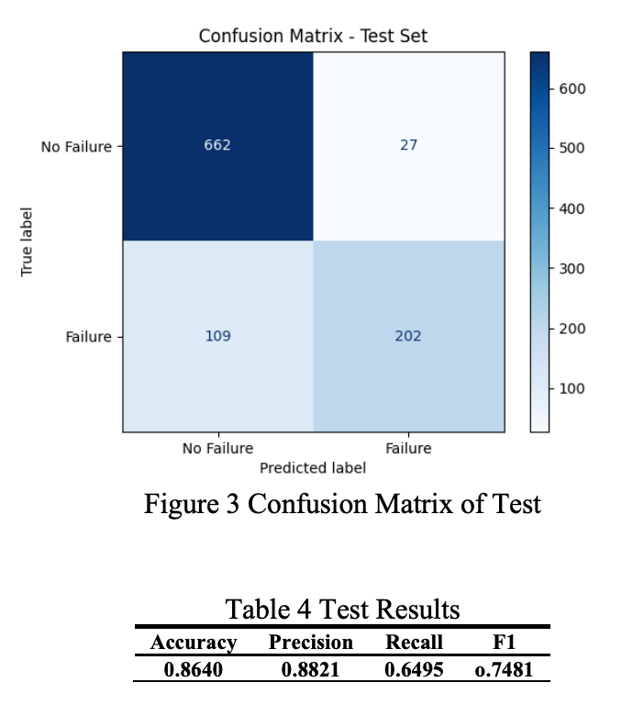
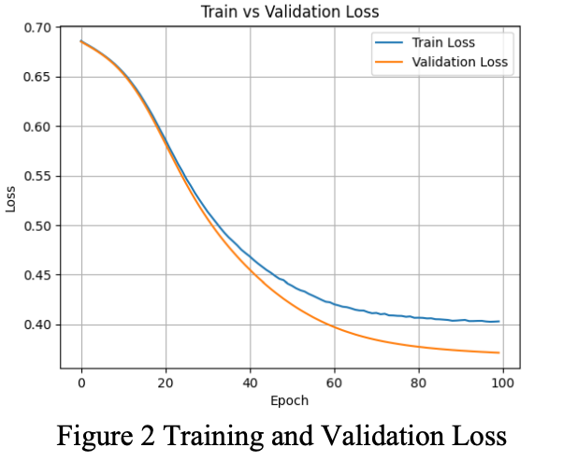
RESULTS

Slide 8
CONCLUSION
CARLA enables safe and scalable testing of AVs under rare and risky scenarios.
The LSTM model can effectively learn temporal patterns leading to failure.
High precision makes it suitable for early warning systems in AVs.
Future work:
Use more diverse maps
Introduce adversarial sensor failures
Apply to other public datasets and do comparation with others frameworks.

Slide 9
THANK YOU!

